Slide 1
Chapter 8
Initiating systems development

Slide 2
Learning objectives
After this lecture, you will be able to:
  explain the importance of conducting a structured initiation phase for a BIS project;
  identify typical tangible and intangible costs and
  benefits associated with the introduction of an information system;
  apply different techniques to select the most appropriate options from different software, hardware and supplier alternatives;
  describe the importance of contracts to a successful outcome to information systems projects.

Slide 3
Management issues
From a managerial perspective, this lecture addresses the following areas:
  How should we assess the feasibility of a project?
  What are the stages and techniques that can be applied to assess feasibility?
  How can the return on investment of a BIS project be assessed?
  How can we manage the risks associated with IS projects?

Slide 4
Initiation and feasibility
Initiation phase: The first phase in an information systems development project. Its aims are to establish whether the project is feasible and prepare to ensure that the project is successful.
Feasibility study: The activity that occurs at the start of the project to ensure that the project is a viable business proposition. The feasibility report analyses the need for and impact of the system and considers different alternatives for acquiring software.

Slide 5
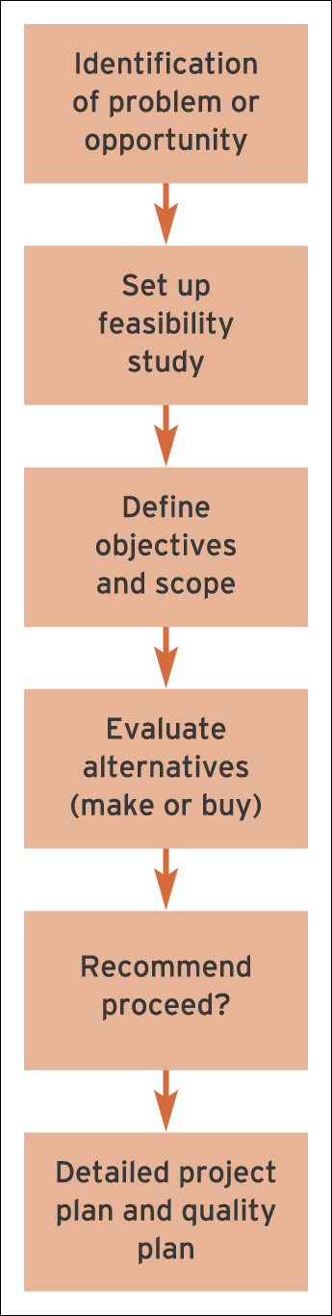
Figure 8.1 Sequence of main activities involved with project initiation

Slide 6
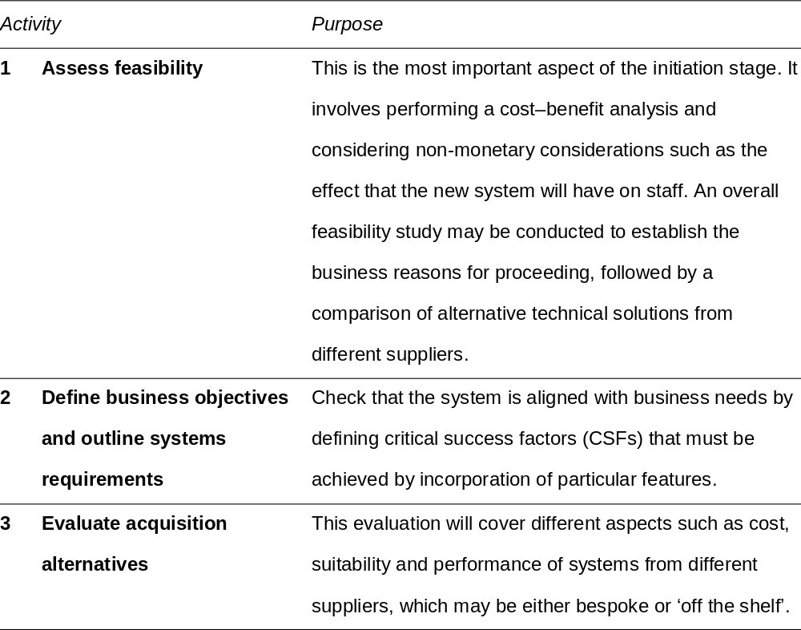
Initiation activities

Slide 7
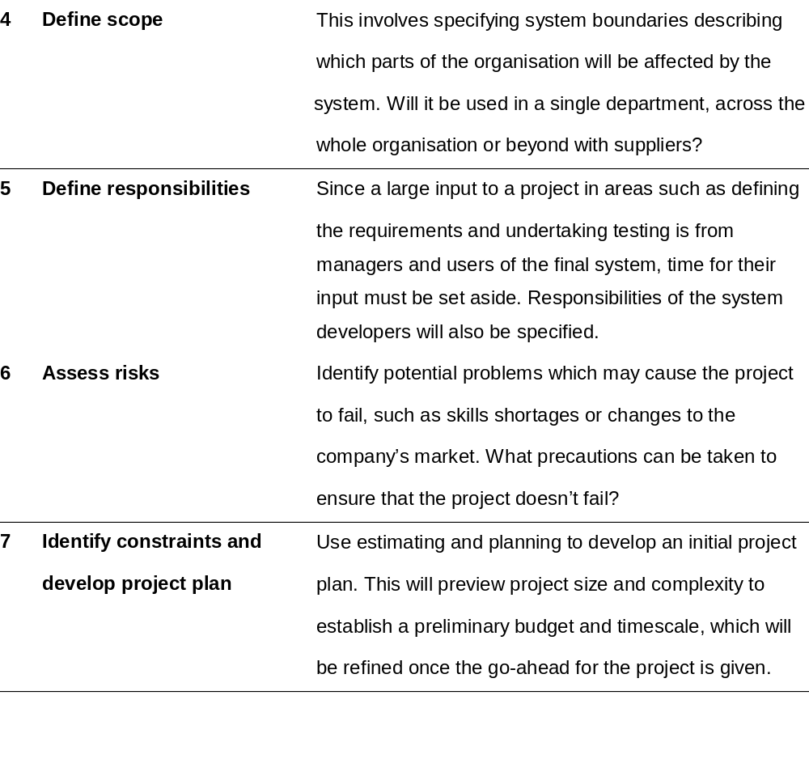
Initiation activities (Continued)

Slide 8
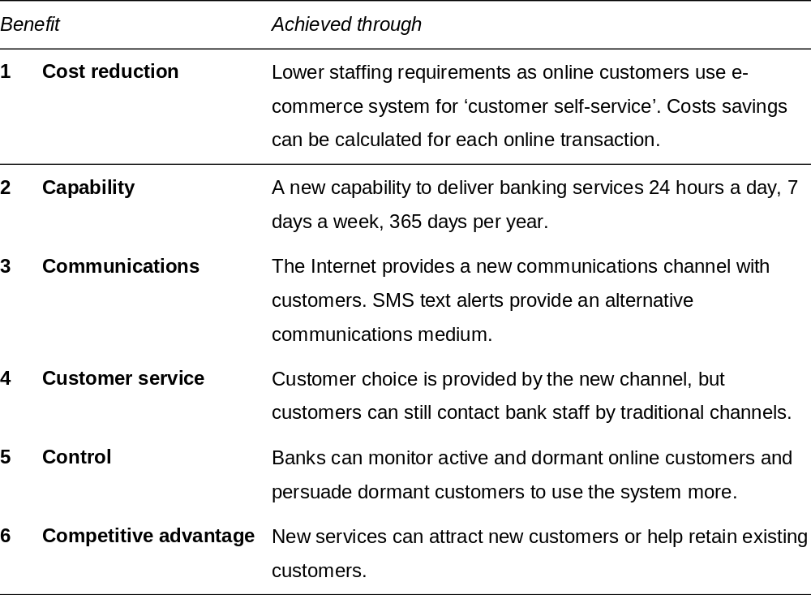
6Cs benefits of IS

Slide 9
Feasibility type
Organisational feasibility: Reviews how well the solution meets the needs of the business and anticipates problems such as hostility to the system
if insufficient training occurs. (Considers the effect of change, given a company’s culture and politics.)
Question answered:
  Will the system meet the business’ needs and help improve its performance?
Technique used to control:
  Critical success factors and key performance indicators. Change management.

Slide 10
Feasibility type (Continued)
Economic feasibility: An assessment of the costs and benefits of different solutions to select that which gives the best value. (Will the new system cost more than the expected benefits?)
Question answered:
  Will the costs outweigh the benefits?
Technique used to control:
  Cost/benefit analysis
  Return-on-investment and payback calculations.

Slide 11
Costs and benefits
Tangible costs: A measure of cost can be calculated for each tangible cost.
Intangible costs: A monetary value cannot be placed on an intangible cost.
Tangible benefits: A definite measure of improvement can be calculated for each tangible benefit.
Intangible benefits: It is not possible to measure intangible benefits.

Slide 12
IS costs
Hardware and software purchase costs
Systems development staff costs if a bespoke or tailored solution is chosen
Installation costs including cabling, physically moving equipment and bringing in new furniture to house the computers
Migration costs such as transferring data from an existing system to the new system or running the new and original systems in parallel until the reliability of the new system is established
Operating costs including maintenance costs of hardware such as replacing parts or upgrading to new versions of software. Staff costs in maintaining the hardware and software and trouble-shooting any problems must also be factored in. Operating costs may also include an environmental audit of the amount of energy and consumables used
Training costs
Wider organisational costs, for example, redundancy payments may need to be made if computerisation leads to loss of jobs.

Slide 13
IS benefits
Improved accuracy
Improved availability and timeliness
Improved usability (easier to understand and
then act on information)
Improved utilisation
Improved security of information

Slide 14
Feasibility type (Continued)
Technical feasibility: Evaluates to what degree the proposed solutions will work as required and whether the right people and tools are available to implement the solution.
Question answered:
  Will it work efficiently (performance, availability
  and stability)?
Technique used to control:
  Risk analysis
  Capacity planning
  Performance and availability modelling.

Slide 15
Feasibility type (Continued)
Operational feasibility: An assessment of how the new system will affect the daily working practices within the organisation.
Question answered:
  Is the system workable on a day-to-day basis?
  Will the system be accepted by end-users into their day-to-day work?
Technique used to control:
  Risk analysis
  Change management
  Usability analysis.

Slide 16
Risk management
Risk management: Aims to anticipate the future risks of an information systems project and to put in place measures to counter or eliminate these risks.

Slide 17
Risk factors
1. Project size
2. Project complexity
3. People issues
4. Project control
5. Novelty
6. Requirements stability

Slide 18
Request for proposals (RFP)
Request for proposals (RFP): A specification drawn up to assist in selecting the supplier and software.

Slide 19
Factors in selecting systems
Functionality: Does the software have the features described to support the business requirements?
Ease of use: For both end-users and initial setup and administration.
Performance: For different functions such as data retrieval and screen display. If used in a customer-facing situation, this will be a critical factor.
Compatibility or interoperability: How well does your solution integrate with other products? This includes what you are using now and what you will be using based on your strategic direction.

Slide 20
Factors in selecting systems (Continued)
Security: This includes how easy it is to set up access control for different users and the physical robustness of methods for restricting access to information.
Stability or reliability of product: Early versions of products often have bugs and you will experience a great deal of downtime and support calls; hence the saying ‘never buy one dot zero’.
Prospects for long-term support of product: For example, if the vendor company is small or likely to be taken over by a predator, will the product exist in three years’ time?
Extensibility: For example, are the features available to accommodate your future needs?

Slide 21
Contracts
Contracts should define the following main parameters:
  business requirements and features of system;
  deliverables such as hardware, software and documentation;
  timescales and milestones for different modules;
  how the project is managed;
  division of responsibilities between different suppliers and the customer;
  costs and method of payment;
  long-term support of system.

